Slide 1
Sex Education
Anatomy, Physiology, and Puberty
Special thanks to University Hospitals, Cleveland, OH

Slide 2
Goals
Learn about your bodies
Answer questions that are uncomfortable to ask
Learn how to stay healthy

Slide 3
Ice-breaker
What are words used for breasts, penis, sex, vagina, etc.?

Slide 4
Puberty
What is it?

Slide 5
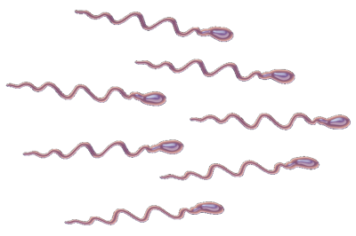
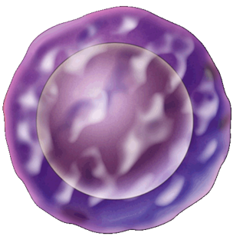
Puberty
When young bodies develop into adult bodies
Boys
Start to develop new feelings and interests
Start to make sperm cells
Girls
Start to develop new feelings and interests
Egg cells start to develop

Slide 6

Why do we make sperm and eggs?
DNA is like the instruction manual for our cells to function
Sperm and eggs each have one half of that instruction manual
When they combine, they make a baby

Slide 7
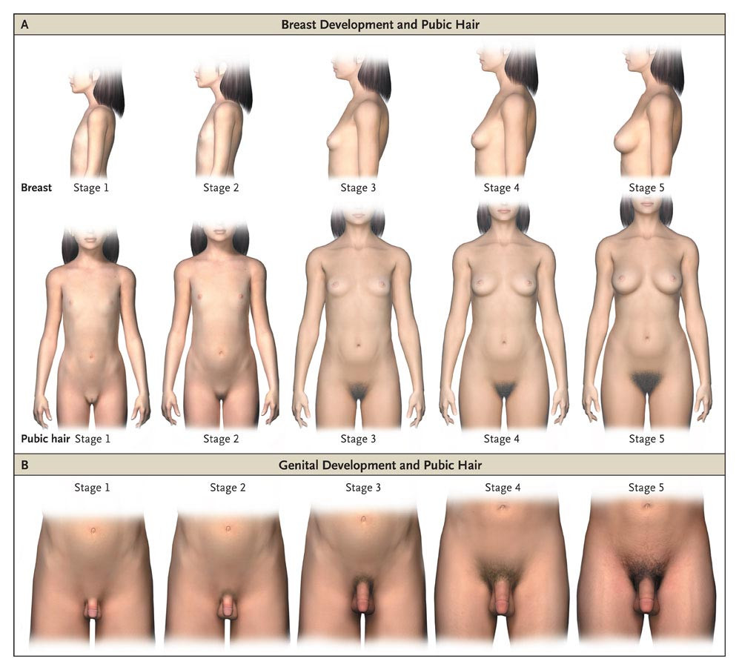
Puberty – Girls
Carel J, Léger J. N Engl J Med 2008;358:2366-2377.
Get taller and heavier
Bones grow bigger and heavier
Hips get wider and more curvy
Face changes shape
Voice gets a little deeper
Hair grows under the armpits, around the genitals (pubic hair)
Hair on arms and legs grows darker
Breasts and nipples get larger
Body sweats more
Internal and external sex organs grow
May have mood swings, sexual thoughts and feelings

Slide 8
Puberty – Boys
Carel J, Léger J. N Engl J Med 2008;358:2366-2377.
Grow taller and heavier
Bones grow bigger and heavier
Nose and jaw get bigger and face gets longer
Hair and skin can become oily → get pimples
Get more muscles
Body sweats more
Hair grows on the face, under the armpits, around the genitals (pubic hair)
May have mood swings, sexual thoughts and feelings

Slide 9
What are the differences between boys and girls?
Just the physical stuff, emotional changes are the same!
Boys: facial hair, shoulders get wider, penis and testicles grow, wet dreams
Girls: hips get wider, ovulation starts

Slide 10
Why does puberty happen?
Hormones are chemicals that the body uses to send messages
The brain uses sex hormones to communicate with the sex organs (e.g. breasts, genitals) to tell them to develop
The main sex hormones are:
Testosterone
Estrogen
Both boys and girls make both, but in different amounts
Boys make lots of testosterone, not so much estrogen
Girls make lots of estrogen, not so much testosterone

Slide 11
When does puberty happen?
Between ages 8 and 17 years old
Usually starts 10-13 for girls, 12-14 for boys
When you start makes no difference to how you develop; no age is better than any other one
Most of the changes happen in a few years, but can happen slowly over many years
No matter when or how you develop,
THIS IS NORMAL!!

Slide 12
True or false?
Teens who get a lot of pimples do not wash often enough
False!
During puberty, the body begins making a lot of oils, which can clog up your skin and cause pimples
This is completely normal
Washing can help a bit, but not make it go away completely

Slide 13
True or false?
All girls are emotional and tearful before their periods
False!
During puberty, some people do get more emotional
Totally normal
This happens EQUALLY to BOYS AND GIRLS
Boys’ hormones actually also have a monthly cycle

Slide 14
Male Anatomy
Get ready for pictures!

Slide 15
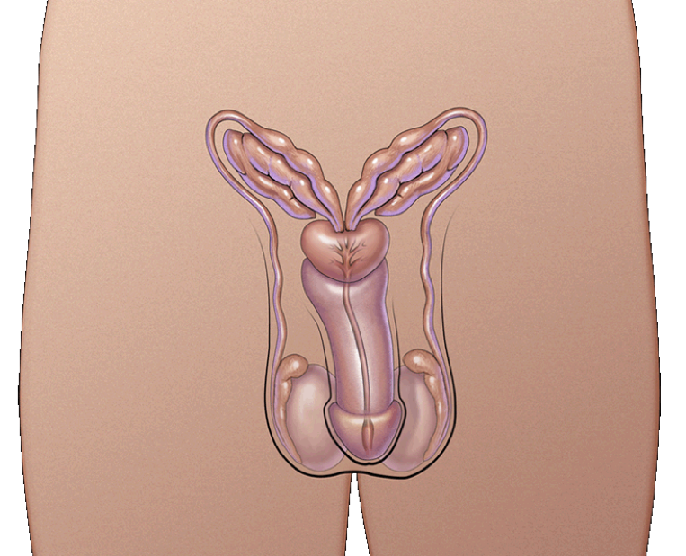
Male reproductive organs (genitals)
Seminal vesicles
Prostate
Vas deferens
Urethra
Penis
Testicles or testes
Scrotum

Slide 16
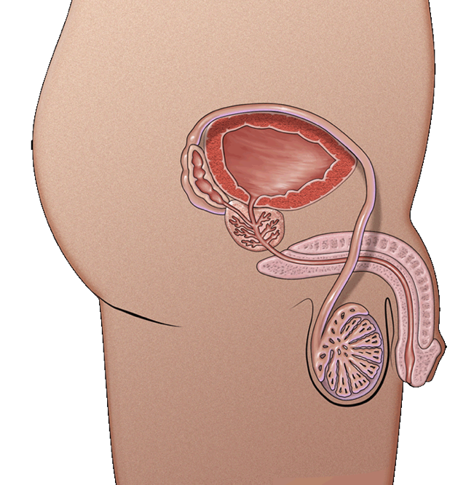
Scrotum
Bag of skin that holds testicles
Keeps them at the right temperature, slightly cooler than the rest of the body
During puberty, gets bigger/baggier and turns a darker color

Slide 17
Testicles/testes
Usually two
One hangs lower than the other
Where sperm are made

Slide 18
Vas deferens
Tube that connects testicle to the seminal vesicle
Passageway for sperm

Slide 19
Seminal vesicles
Add sperm to semen

Slide 20
Prostate
Adds nutrients to semen

Slide 21
Urethra
Tube through which urine and semen leave the body

Slide 22
Penis
Organ that hangs outside the body
Wide range of shapes and sizes
Determined by our genes and random chance

Slide 23
What’s this?
Bladder!

Slide 24
Recap

Slide 25
What’s going on?
Hormones from the pituitary gland (in the brain) make the testicles…
grow
make more testosterone
produce sperm
After puberty you make 200,000-400,000 sperm cells every day for the rest of your life
Sperm build up in tubes around the testicles
Semen is a mix of sperm and fluids from the prostate

Slide 26
How does the semen come out?
If semen is going to come out, the penis is likely to be erect
A penis gets erect when blood rushes into it
Muscles push the semen into the urethra and out the penis
Ejaculation

Slide 27
Female Anatomy
More pictures!

Slide 28
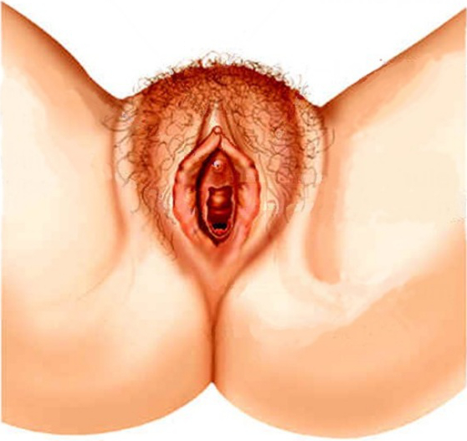
Vulva
All of the external parts of the female sex organs

Slide 29
Labia majora
Labia: Latin for lip
Majora: Latin for great

Slide 30
Labia minora
Labia: Latin for “lip”
Minora: Latin for “lesser”

Slide 31
Clitoris
Bundle of nerves associated with sensation
Same as in the tip of the penis

Slide 32
Urethral opening
Opening for urine
Not a sex organ
In men, urine and semen come out of the same hole, but not in women

Slide 33
Vaginal opening
Entrance to the vagina
Hymen
Thin piece of skin that may cover part of the opening
Often small or missing
Can break without sex

Slide 34
Anus (not pictured)
End of the digestive tract

Slide 35
Recap

Slide 36
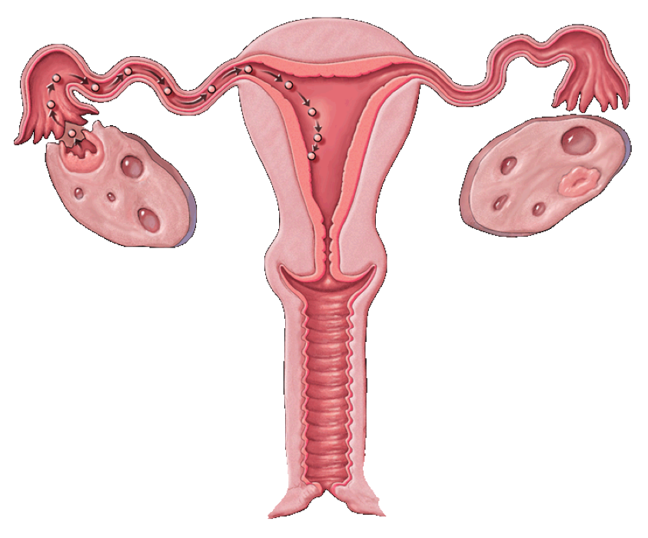
Vagina
Warm, soft, moist passageway that connects the uterus to the outside

Slide 37
Cervix
Lower part of the uterus
Makes mucus to keep sperm alive
Has opening in the center
Menstrual fluid (“blood”)
Sperm
Dilates during labor to let the baby out

Slide 38
Uterus (“womb”)
Massive muscle!
Where a developing baby (fetus) grows and is fed
Where “the period” comes from

Slide 39
Fallopian tubes
Tubes between the uterus and an ovary
Where the egg meets sperm

Slide 40
Ovary
Store egg cells
Women don’t make any new ones after they are born!
Make female sex hormones
There are others besides estrogen, but we don’t have time to talk about them

Slide 41
Recap

Slide 42
Menstruation (“periods”)
Girls are born with hundreds of thousands of tiny eggs, called ova (one is called an ovum)
These egg cells are only half-formed
At puberty, hormones tell the ovaries to start developing and releasing ova
Usually one ovum at a time develops and is released from an ovary

Slide 43
Menstruation (“periods”)
While an ovum develops in the ovary, the uterus starts to grow a thick lining on the inside wall
The lining has lots of tiny blood vessels
The lining is there to protect and feed a fertilized egg, which is an egg that has combined with a sperm
This cycle of developing an ovum and releasing it happens every month (until the ova run out)
“Menstrual cycle”

Slide 44
Path of an egg (ova)
Ovary → fallopian tube → uterus
If the egg combined with a sperm, it sticks to the uterus and begins to grow
If not, the uterus begins to break down (“bleed”) and everything flows out through the vagina

Slide 45
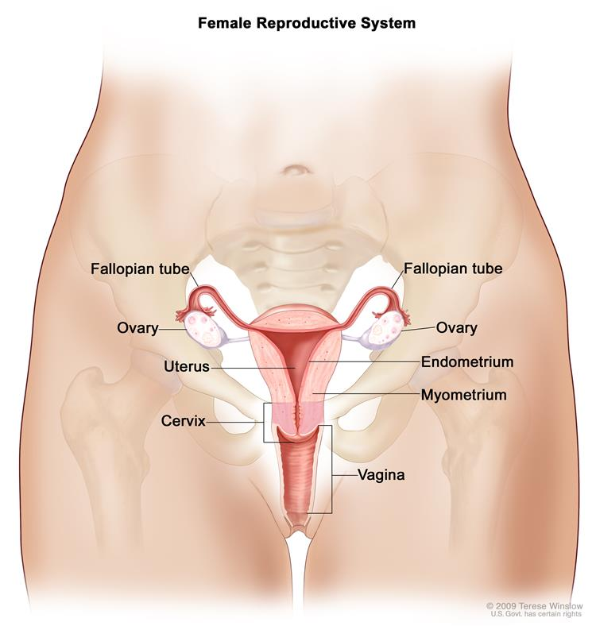
How big is all this stuff?
Uterus is about the size of a pear (if not pregnant)
https://www.cancer.gov/types/ovarian/patient/ovarian-germ-cell-treatment-pdq

Slide 46
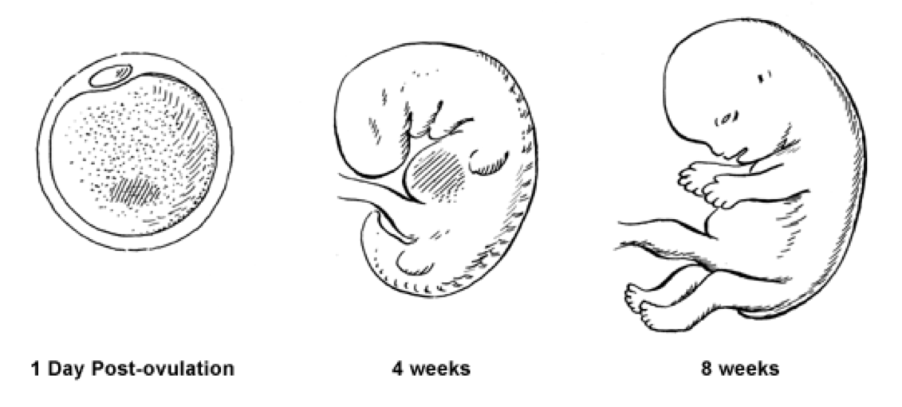
Pregnancy
When a fertilized egg implants into the lining of the uterus, the woman becomes pregnant
A zygote develops into an embryo, an embryo develops into a fetus, and when a fetus is born, a new baby enters the world
This usually takes about 38 to 42 weeks

Slide 47
Sex
Don’t worry, no pictures

Slide 48
Types of sex
Vaginal sex (penis-in-vagina intercourse)
Oral sex (mouth-to-genital contact)
Anal sex (penis-in-anus intercourse)
Fingering or hand jobs (hand-to-genital contact)
Dry humping (genital rubbing)
Touching yourself (masturbation)

Slide 49
What’s the difference?
All of these sexual activities, except masturbation, can carry the risk of sexually transmitted infections (STIs)

Slide 50
Where does the penis go during penis-in-vagina sex?
Only in the vagina
The cervix is sealed shut and cannot open

Slide 51
Questions?

